Slide 1
Turkish News Categorization Using Feedforward Neural Networks
Esra Şekerci

Slide 2
Content
Neural networks
Neural network achritectures
Feedforward networks
Dataset Overview
Preparing the Dataset
Tokenization and Creating a Vocabulary
PyTorch Tensors
Fully Connected Neural Network
Results
Future Works
Conclusion

Slide 3
Neural Networks
These are foundational tools in pattern recognition, utilizing interconnected networks of nonlinear units.
They mimic the interconnected structure of the human neural system.
Neural networks leverage principles of parallel processing, inspired by how human information systems operate.

Slide 4
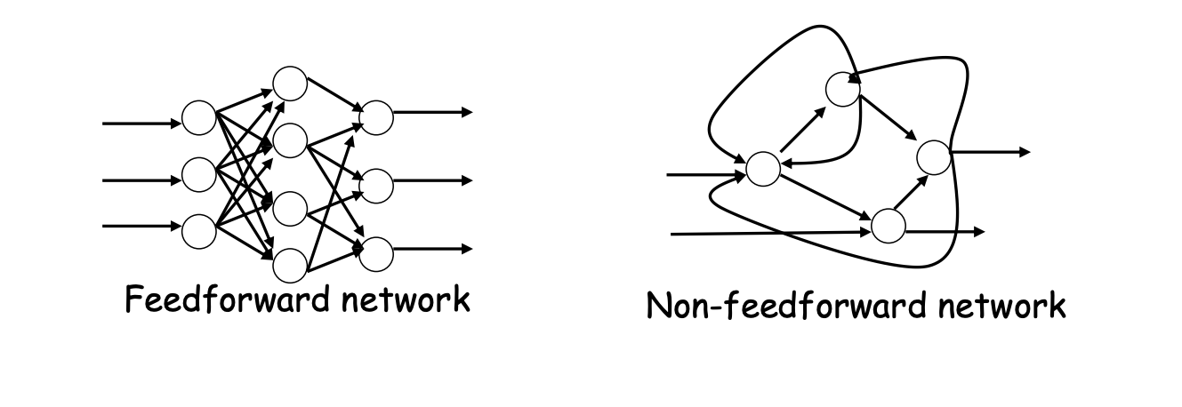
Neural Network Architectures
There are two fundamental neural network architectures

Slide 5
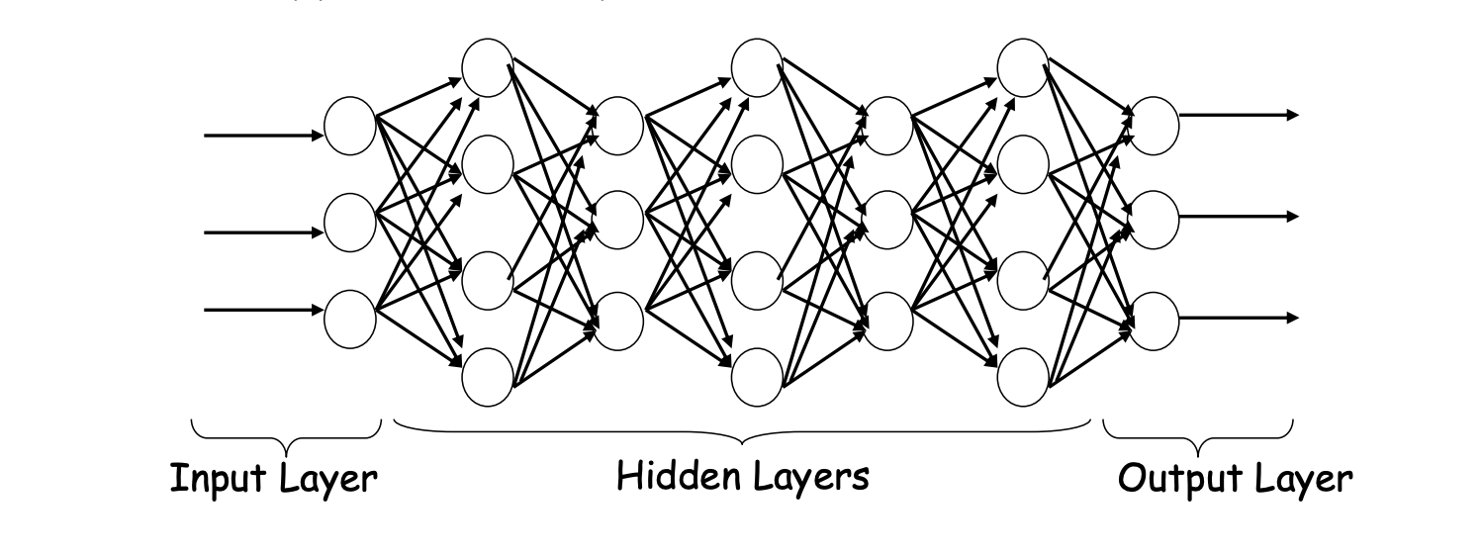
Feedforward Networks
A typical multilayer feedforward network structure

Slide 6
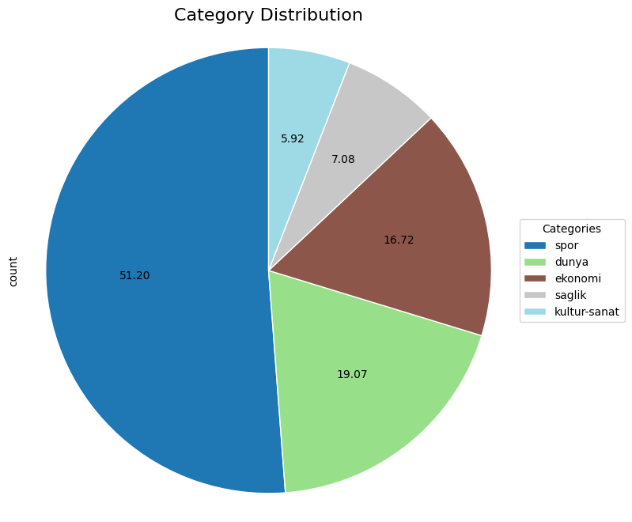
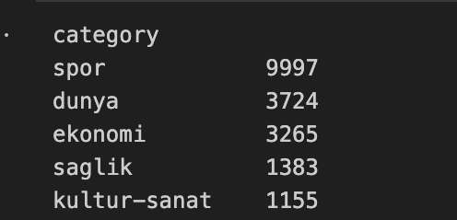
Dataset Overview
Source: Kaggle
Description: Contains 19,524 Turkish news texts categorized into 5 classes.

Slide 7

Preparing the Dataset
Removing Stopwords
Cleaning URLs and Emails
Handling Punctuation and Digits
Dealing with Specific Characters
Normalization and Final Cleanup
Integration and Output

Slide 8
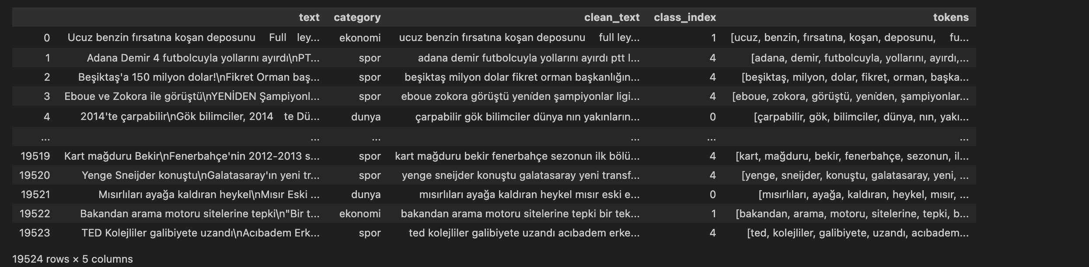
Tokenization and Creating a Vocabulary
To be able to analyze the data, we need to split each text into small units. This process is called "tokenization."
Vocabulary size: 32,396

Slide 9
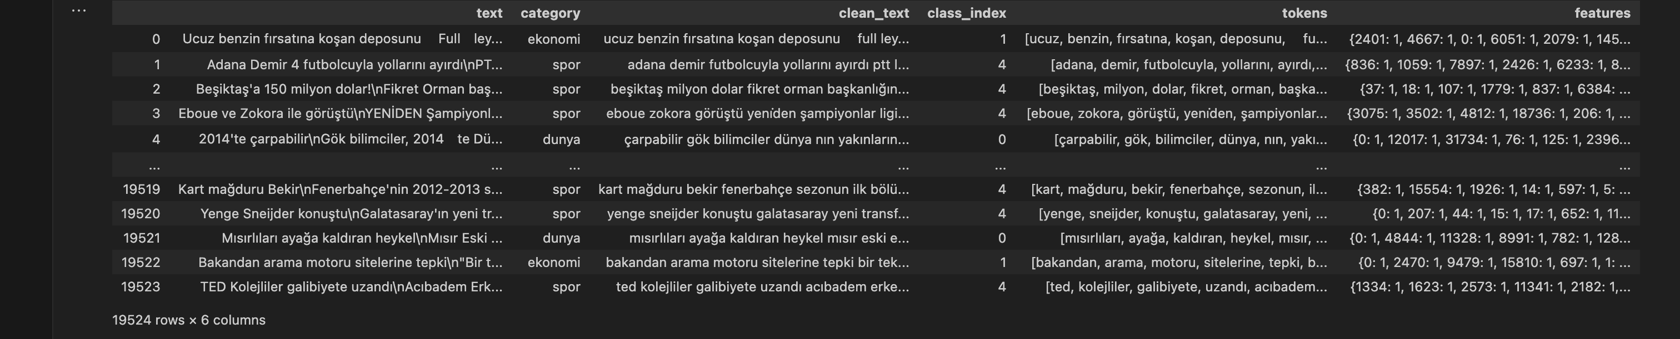
PyTorch Tensors
The final preprocessing step is converting the features and the class indices into PyTorch tensors.
PyTorch provides the DataLoader class which can be used for shuffling the data and splitting it into minibatches. In order to create a DataLoader, we need the data to be in the form of a PyTorch Dataset.
This approach allows the model to learn from the frequency of tokens in each article, enabling it to classify or predict labels based on the text content.

Slide 10
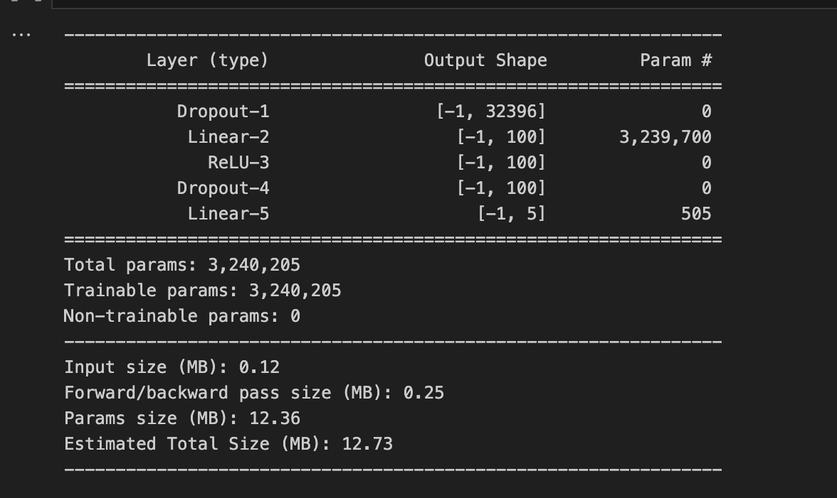
Fully Connected Neural Network
Here, our model consists of two linear layers, each one preceded by a dropout layer.

Slide 11
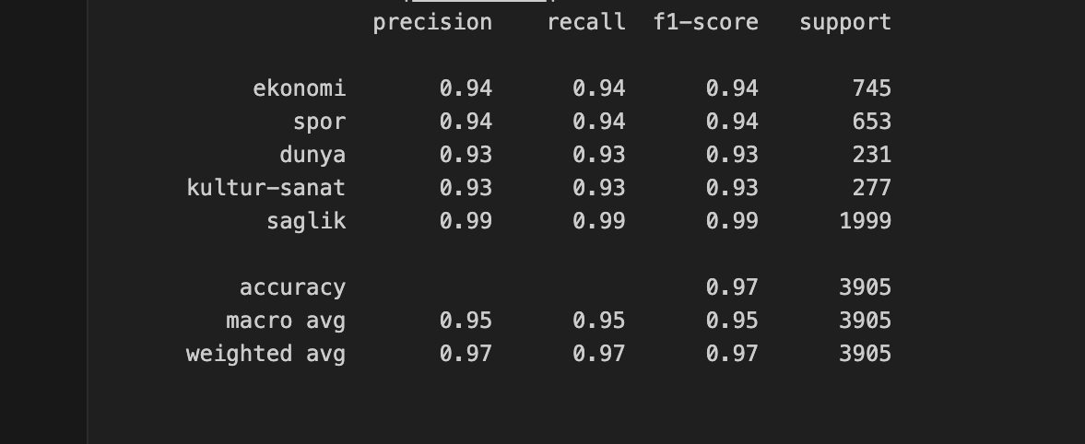
Results
With our feed-forward neural architecture, we have achieved an accuracy of 97%.

Slide 12
Future Works
Handling Imbalanced Data
Increasing Number of Categories

Slide 13
Conclusion
With our feedforward neural network, we achieved an accuracy of 97% in categorizing Turkish news into five distinct categories.
By employing rigorous text preprocessing techniques and leveraging PyTorch for model development, we ensured our data was clean and ready for robust analysis.
Moving forward, we aim to address challenges such as class imbalance and explore opportunities to expand the model's capabilities to encompass a wider range of news categories.

